Slide 1

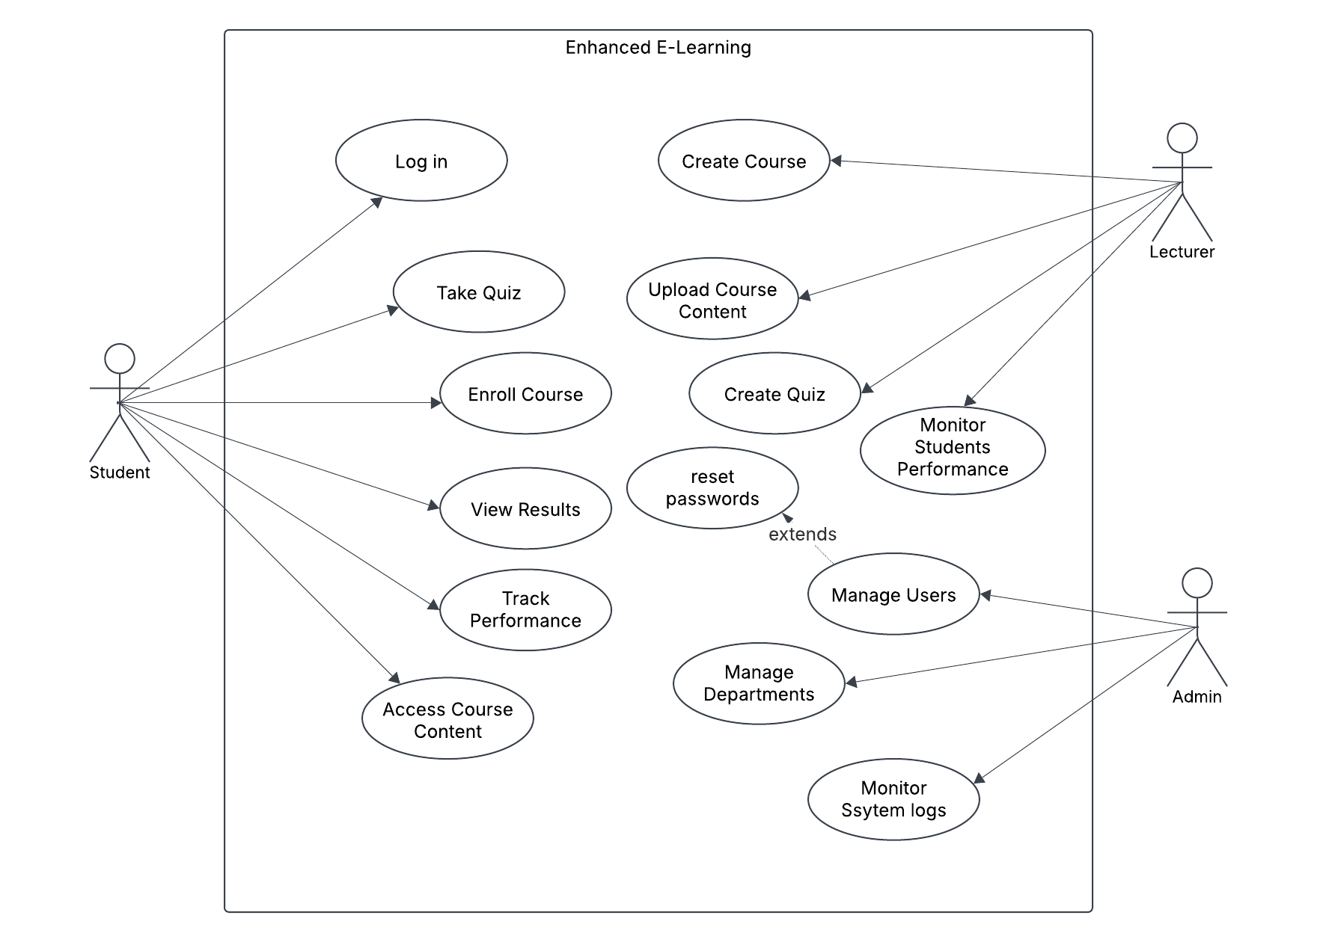
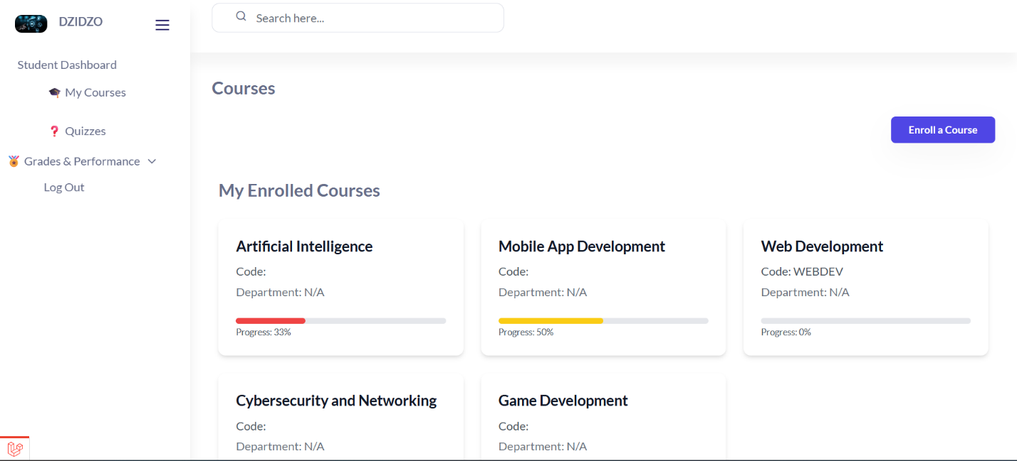
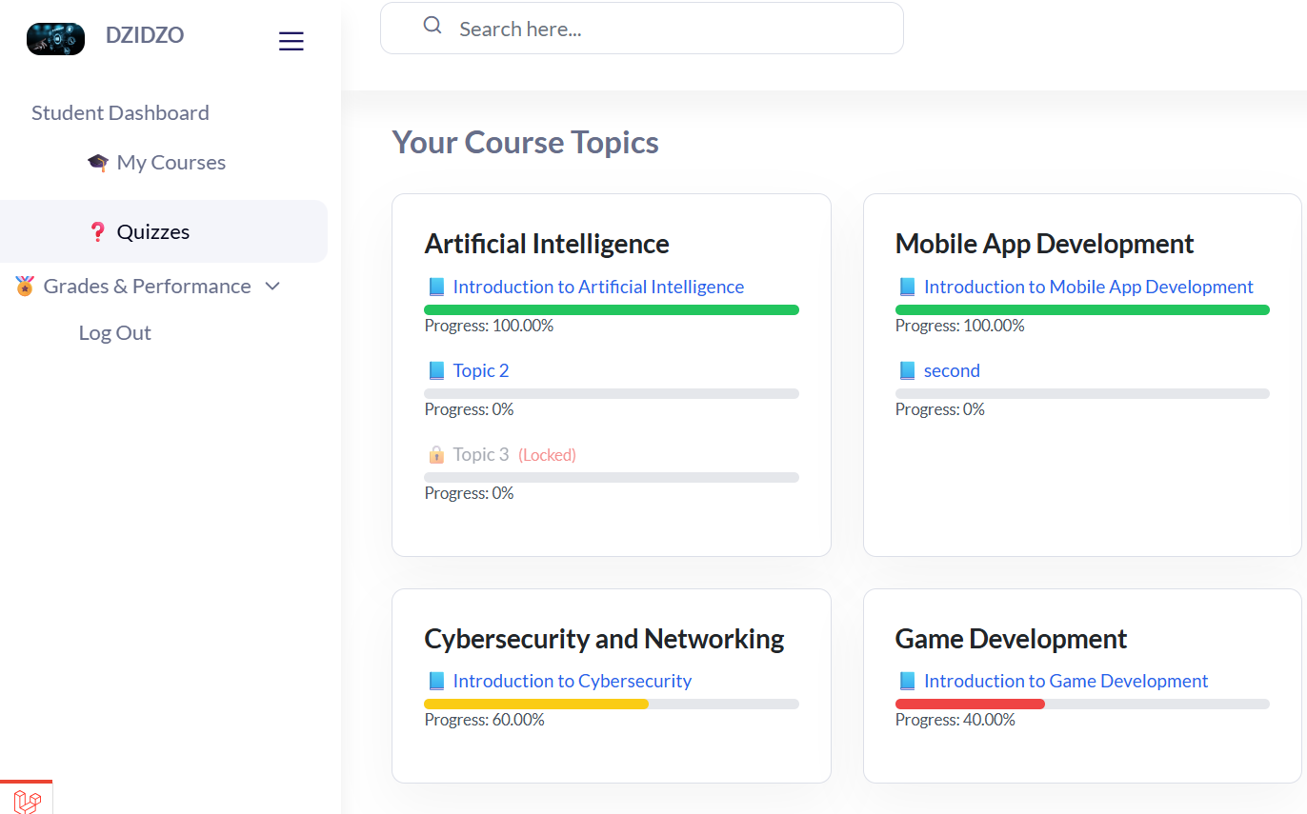
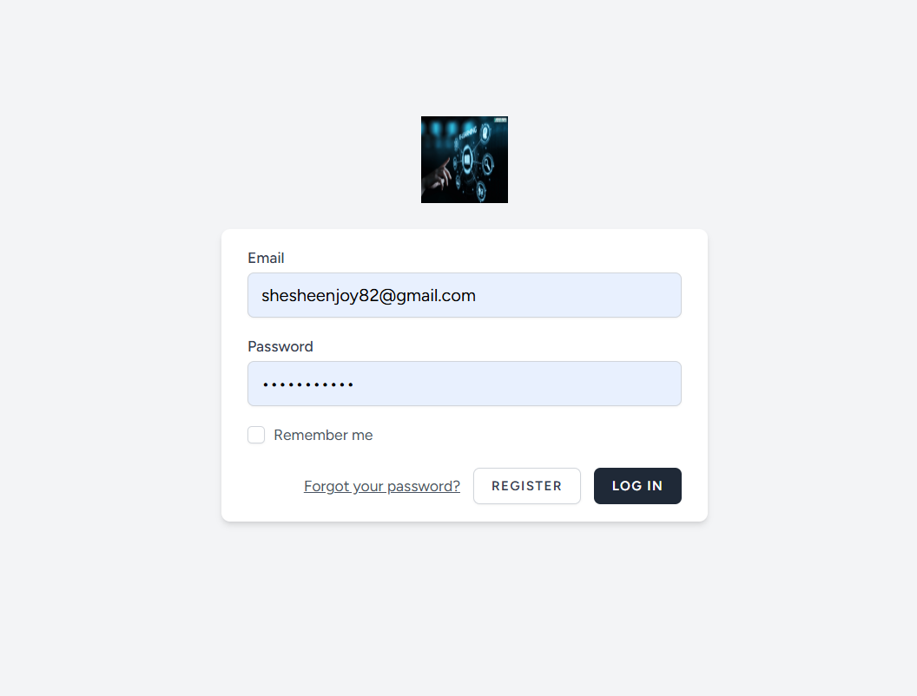
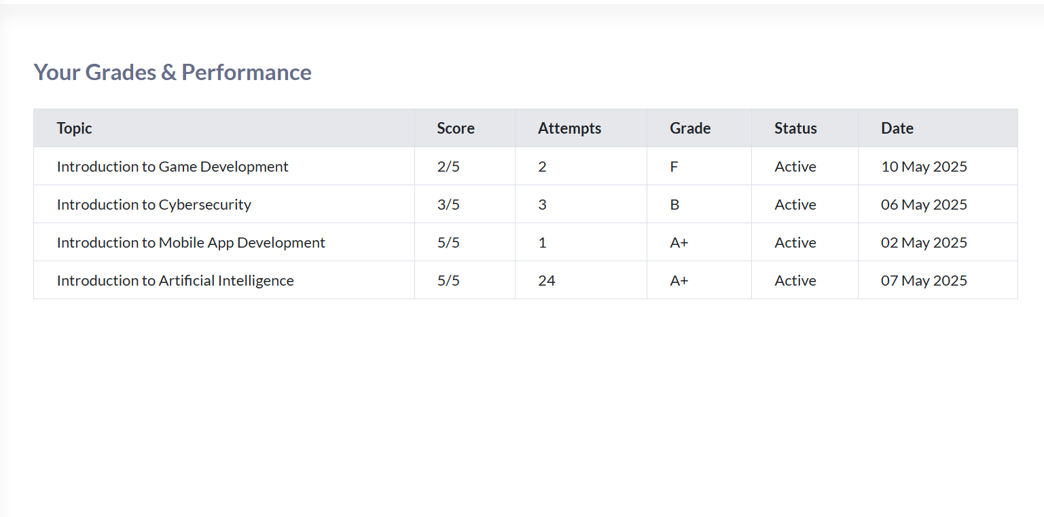
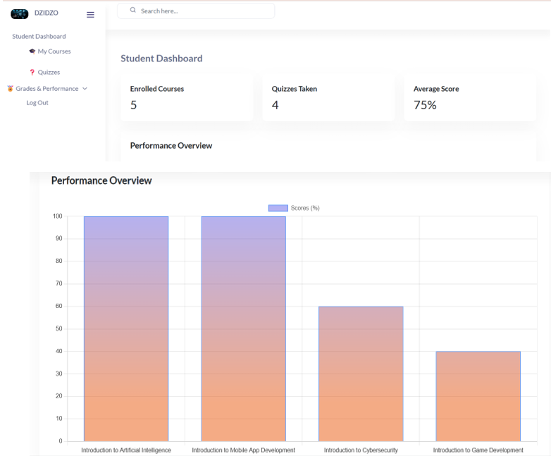
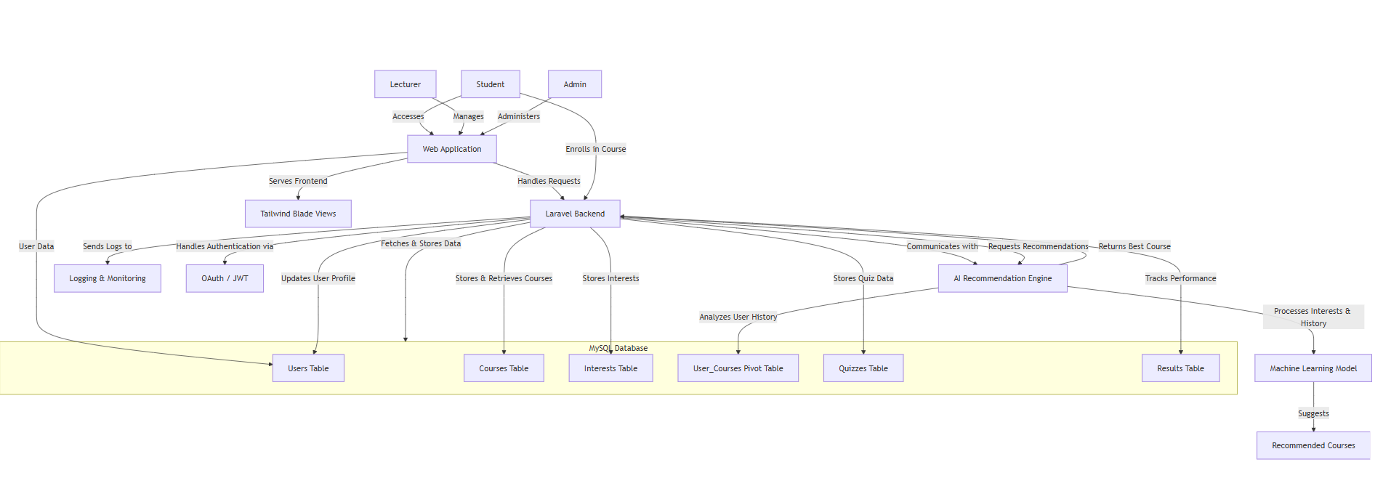
AI ENHANCED E-LEARNING
Sheshe Enjoy - Software Engineering Department
1.0 Abstract
4.0. Overview of the developed application
7.0. Use Case Diagram
This project presents the development of an AI-powered e-learning platform designed to personalize the learning experience through intelligent course and topic recommendations. The system leverages content-based filtering techniques and performance analytics to match students with relevant learning materials based on their interests and quiz outcomes. Users can register, enroll in courses, take quizzes, and receive dynamic feedback and recommendations. Administrators are provided with tools to manage content and monitor learner progress through a centralized dashboard. The backend is developed using Laravel, with a modern React frontend and machine learning functionalities integrated via RubixML. By combining educational technology and artificial intelligence, the platform aims to increase learner engagement, improve academic performance, and support adaptive learning pathways..
The developed application is an AI-driven e-learning platform designed to enhance learner engagement and performance through personalized recommendations and intelligent feedback. Built using Laravel (PHP) for the backend and the frontend, the system integrates user registration, course enrollment, quiz assessments, and real-time progress tracking.
Key features include:
Personalized Course & Topic Recommendations: Uses keyword matching and cosine similarity based on user interests and quiz performance.
Student Dashboard: Allows learners to view enrolled courses, take quizzes, and track their progress.
Admin Dashboard: Enables administrators to manage courses, users, quizzes, and monitor overall analytics.
AI Recommendation Engine: Suggests content tailored to the learner’s performance and preferences.
Performance Feedback: Students receive feedback after each quiz, helping them understand areas for improvement.
2.0. Introduction
8.0. Screenshots
With the rapid growth of online learning, students often face difficulties selecting relevant courses that match their interests and learning pace. This project addresses that challenge by developing an AI-enhanced e-learning platform that recommends personalized content. The system integrates user behavior, quiz performance, and interest-based filtering to adaptively guide learners through suitable courses and topics. By combining intelligent recommendations with a user-friendly interface, the platform aims to improve learner engagement, performance, and satisfaction.
5.0. Objectives
1. To build an AI system that recommends personalized courses based on user interests and activity.
2. To implement an adaptive learning path based on quiz performance.
3. To track learner progress and provide smart feedback for improvement.
3.0. Problem definition
Traditional e-learning platforms provide the same content structure to all learners, regardless of their individual interests, prior knowledge, or performance. This "one-size-fits-all" approach often leads to decreased motivation, poor retention, and low course completion rates. Students may find it difficult to stay engaged when content is either too advanced or too basic, or when there’s no clear guidance on what to study next.
Additionally, these platforms typically lack intelligent feedback systems and adaptive learning paths, which are critical for effective learning in diverse student populations. Without personalized support, learners receive limited insights into their progress, and administrators cannot easily identify areas where interventions are needed.
This project addresses these limitations by proposing an AI-enhanced e-learning platform that adapts to individual user behavior and quiz performance. By providing smart recommendations and progress tracking, the system aims to improve engagement, learning outcomes, and the overall e-learning experience.
6.0. System Overview
Conclusion
The AI-Enhanced E-Learning Platform tackles the major challenges freelancers face in obtaining personalized, flexible, and effective education. By utilizing AI to recommend tailored courses, adjust learning paths based on performance, and provide insightful progress tracking, the platform ensures freelancers gain skills efficiently. With a scalable and intelligent architecture, the system is poised for future enhancements, including machine learning, NLP, and blockchain integration. In the end, this platform equips freelancers to remain competitive in the fast-paced digital economy.
Supervisor – Mrs S Zindove

